Slide 1
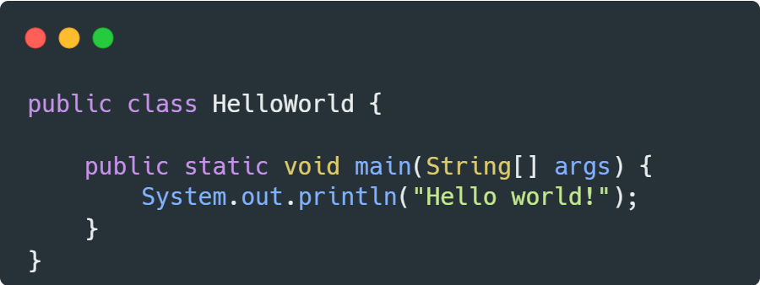
Key Changes & New Features in Java LTS Versions

Slide 2
TIMELINE PROGRESS
Java 11
Java 21
Added var for lambda parameters, HTTP Client API, and removed JavaFX from the JDK.
Introduced Virtual Threads, String Templates, and Record Patterns for performance and simplicity.
2014
2021
Java 8
2018
Java 17
2023
Introduced Lambdas, Streams API, and Optional for cleaner and functional programming.
Introduced Sealed Classes, improved Pattern Matching for switch, and provided Long-Term Support (LTS).

Slide 3
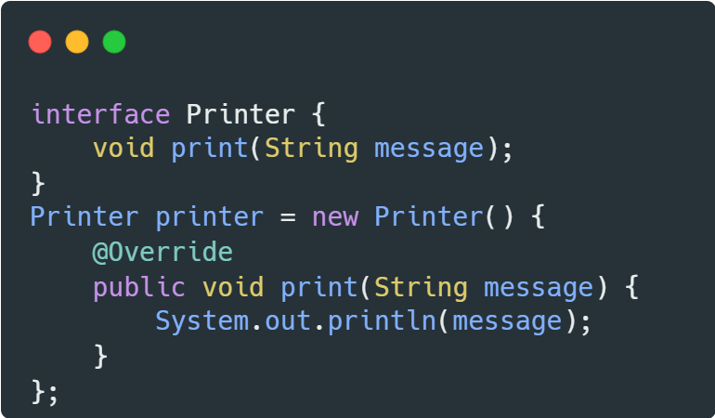
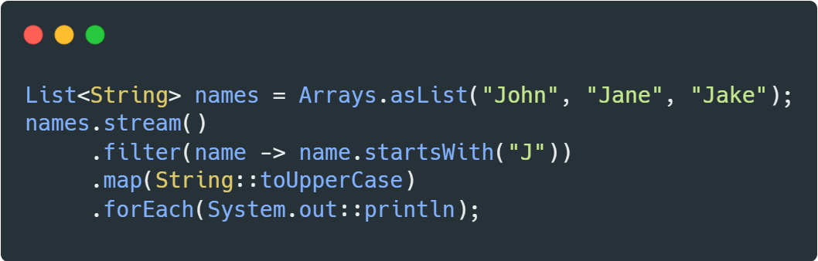
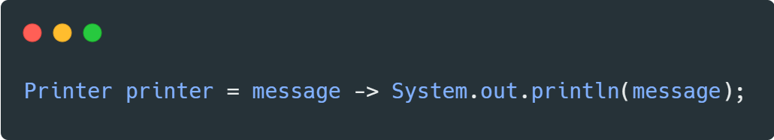
Java 8 (2014) — A New Era Begins
Key Changes:
Lambda Expressions — simplified functional programming;
Stream API — functional data processing;
Default Methods — interface evolution without breaking changes;
Date/Time API — replace java.util.Date with modern java.time;
Optional — handle null safely.

Slide 4
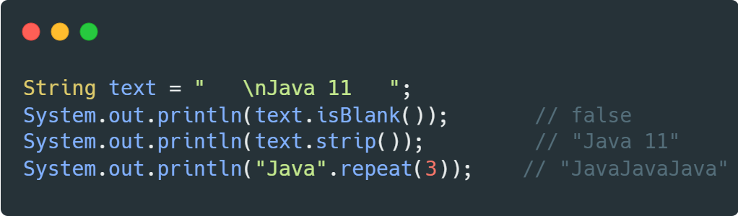
Java 11 (2018) — Modernizing the Platform
Key Changes:
File Methods — readString(), writeString();
New String Methods — isBlank(), lines(), strip(), stripLeading(), stripTrailing(), repeat();
Collection to an Array with a new toArray() method;
New HTTP Client (Finalized) — replace HttpURLConnection with modern client;
Local-Variable Syntax for Lambda (var) — concise lambda parameter declarations;
Removed Deprecated Features — removal of JavaFX, Corba, etc.

Slide 5
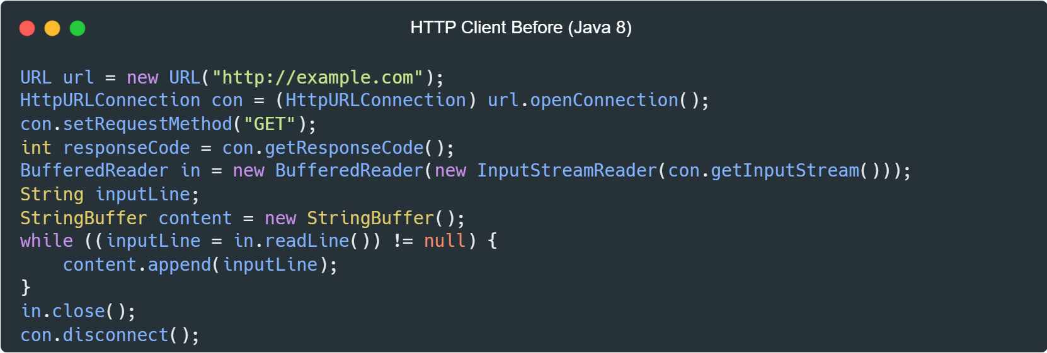
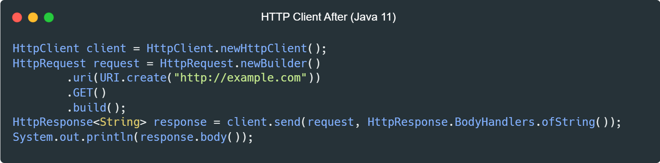
Java 11 (2018) — Modernizing the Platform

Slide 6
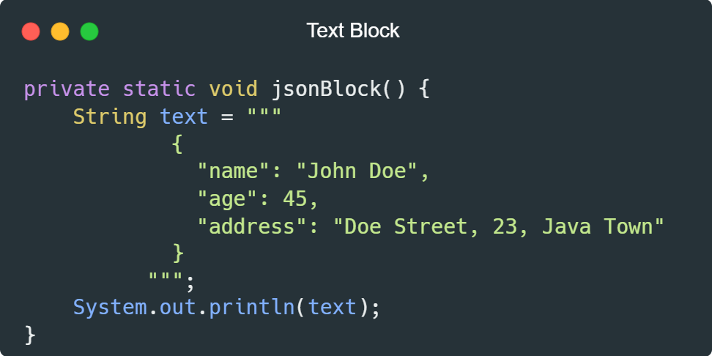
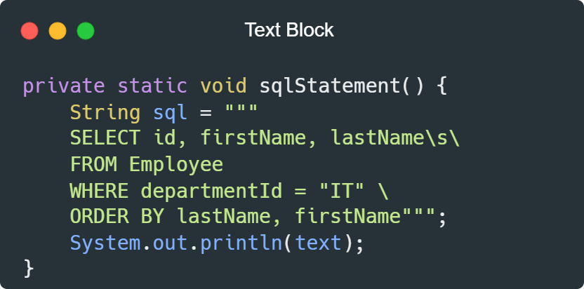
Java 17 (2021) — Stability and Sealed Classes
Key Changes:
Text Blocks — to make the code more readable and to avoid unnecessary string formatting;
Record Type — a special kind of immutable class which is meant to replace data transfer objects (DTOs);
Pattern Matching for Switch (Preview) — cleaner, more readable switch syntax;
Sealed Classes — control which classes can extend your class;
Context-Specific Deserialization Filters — improved serialization security.

Slide 7
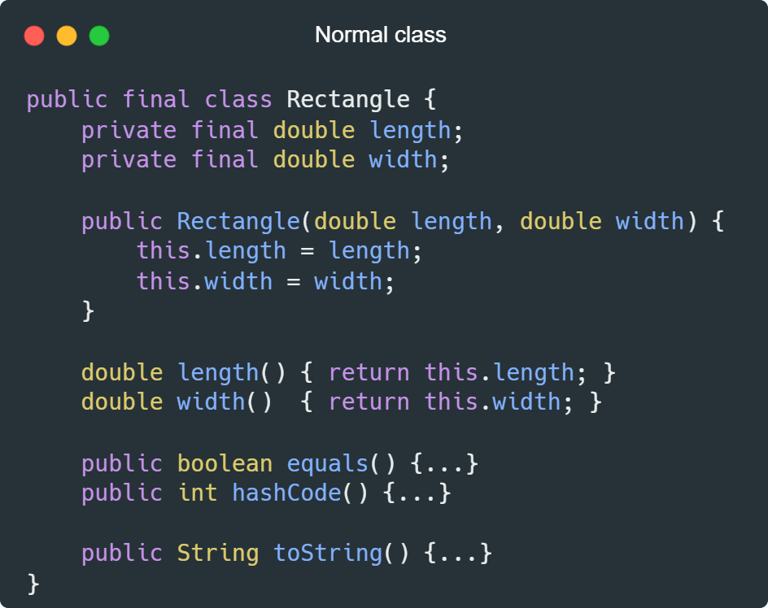
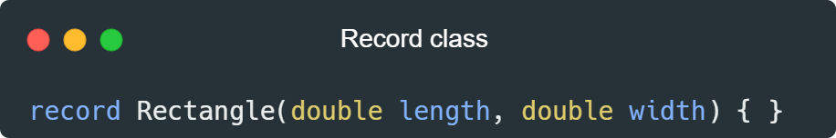
Java 17 (2021) — Stability and Sealed Classes
Record classes, which are a special kind of class, help to model plain data aggregates with less ceremony than normal classes.

Slide 8
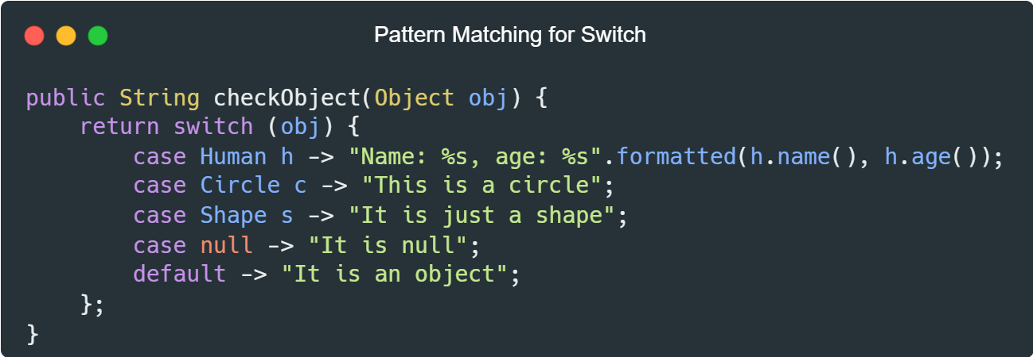
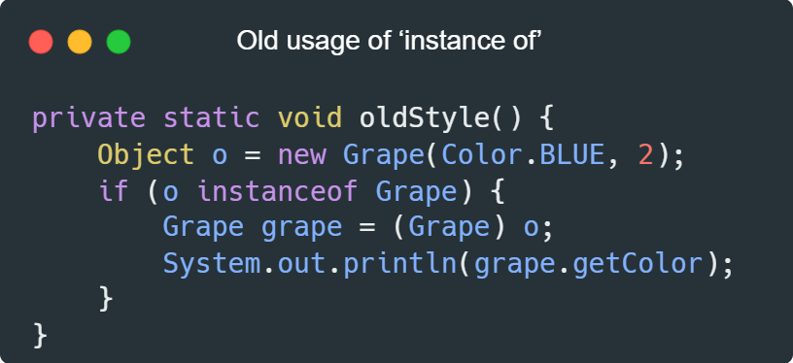
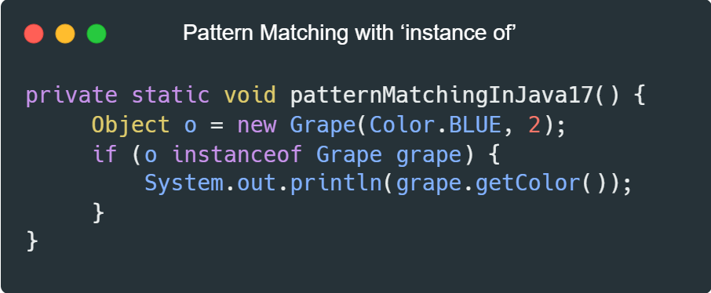
Java 17 (2021) — Stability and Sealed Classes

Slide 9
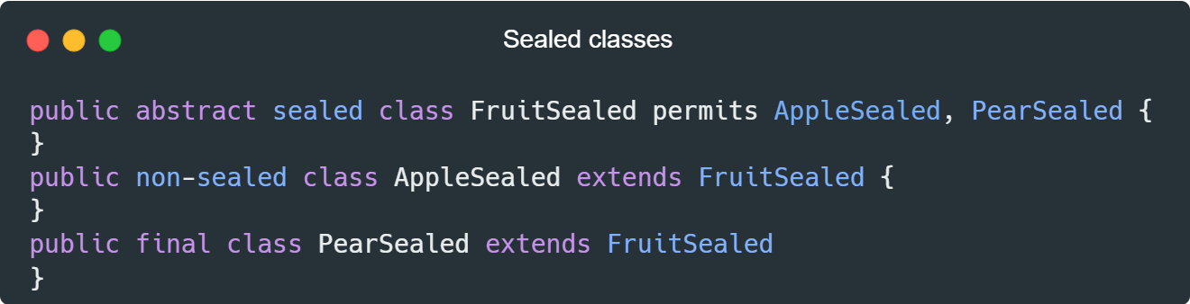
Java 17 (2021) — Stability and Sealed Classes
As we see, we use a new keyword sealed to denote that this is a sealed class. We define the classes that can be extended using the permits keyword. Any class which extends the sealed class can be either final like PearSealed or can be extended by other classes by using the non-sealed keyword when declaring the class as with AppleSealed.

Slide 10
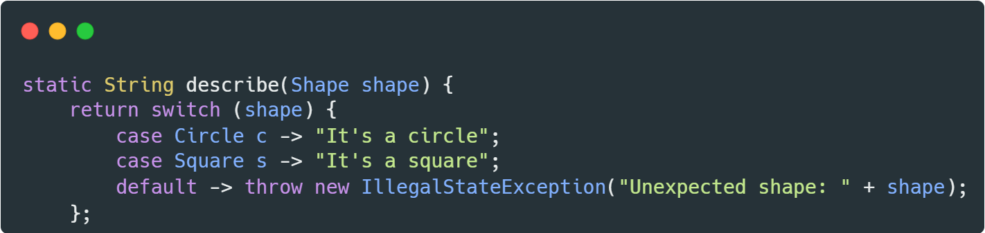
Use Cases for Sealed Classes
Controlling Inheritance:
Prevent unauthorized or unintended inheritance.
Makes type hierarchies easier to understand and maintain.
Safety and Performance:
The compiler and IDE can perform exhaustive type checks, improving static analysis and code completion.
Pattern Matching:
When used with switch expressions, sealed classes ensure all possible subclasses are handled.

Slide 11
Use Cases for Sealed Classes
When to use Sealed Classes?
When the inheritance structure is fixed, and all possible subclasses are known in advance.
To enforce predictable behavior and strict type control.
To simplify working with subclasses, especially in pattern matching.
When not to use them?
If the inheritance hierarchy needs to be flexible or open to third-party extensions.
When restrictions don’t provide significant benefits in your use case.

Slide 12
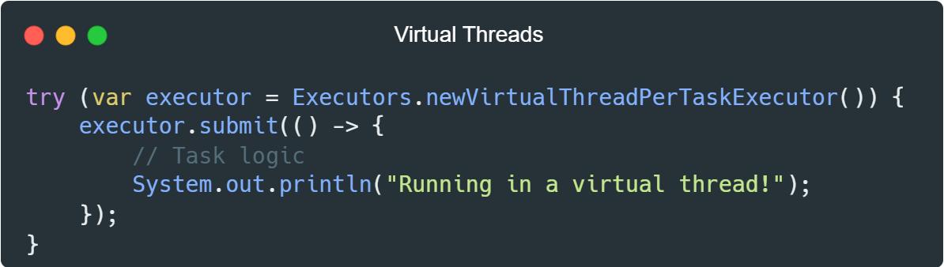
Java 21 (2023) — Performance and Modern Features
Key Changes:
Virtual Threads (Standard) — revolutionizing concurrency with lightweight threads;
Sequenced Collections — List, Set, Map with guaranteed iteration order;
Pattern Matching for Switch (Standard) — full release of modern switch usage;
Record Patterns (Standard) — decompose records in pattern matching;
Unnamed Patterns and Variables (Preview) — ignore parts of patterns you don’t need;
String Templates (Preview) — multi-line, easy-to-read string interpolation

Slide 13
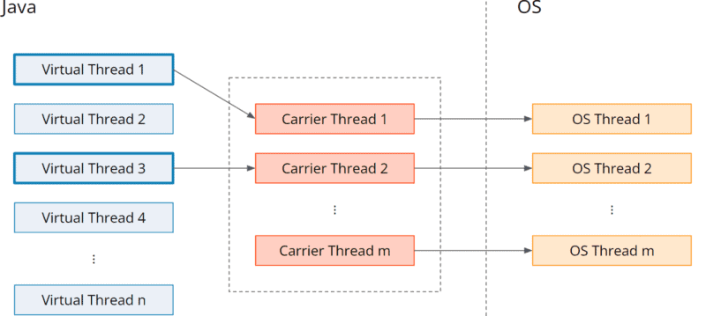
Java 21 (2023) — Performance and Modern Features
Virtual Threads
Source

Slide 14
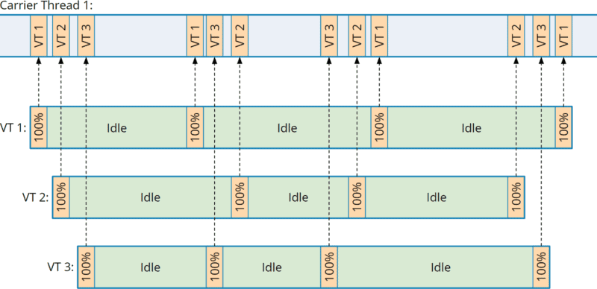
Java 21 (2023) — Performance and Modern Features
Virtual Threads
Mapping three virtual threads to one carrier thread
Source

Slide 15
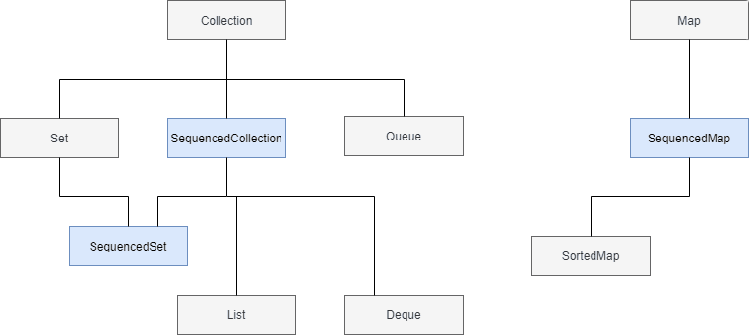
Java 21 (2023) — Performance and Modern Features
Sequenced Collections

Slide 16
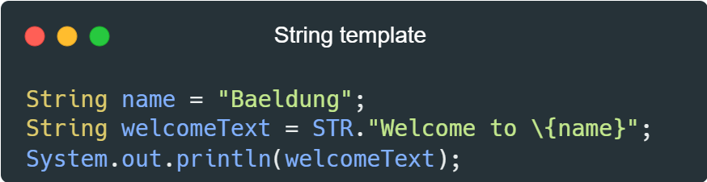
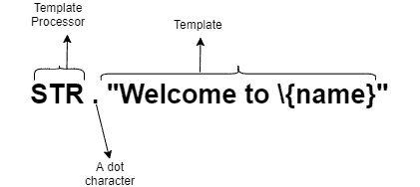
Java 21 (2023) — Performance and Modern Features

Slide 17
Sources and References
Medium
GeeksforGeeks
Bueldung
Pretius
Understanding Java Virtual Threads

Slide 18
THANK YOU!

